Slide 1
EECS-731 Understanding climate change with data-science
Team Oracle
Austin Adams
Pushkar Singh Negi
Ravali Kondreddi
Ronald Moore
Waqar Ali

Slide 2
Introduction
What is this project about?
What is climate-change?
Make hypothesis about factors which cause climate-change
Consumption of fossil-fuels
Emission of CO₂
Population increase
Melting of polar ice-caps
Emission of Ozone depleting substances

Slide 3
Introduction
Role of Data-Science
Identify if we can correlate the trends in the identified factors over the years with climate-change trend
Use classification / clustering techniques to make predictions
Explore the occurrence of natural disasters in the last century
Correlate with climate change trend
Use time-series forecasting to predict future disaster trend

Slide 4
“ Climate change is a change in the statistical distribution of weather patterns when that change lasts for an extended period of time .”
Wikipedia

Slide 5
Data Exploration

Slide 6
Global Temperature
Features
Timestamp
Average Land Temperature (TempLand)
Uncertainty in Average Land Temperature
Max Land Temperature
Uncertainty in Max Land Temperature
Average Land and Sea Temperature (TempGlobal)
Uncertainty in Average Land and Sea Temperature

Slide 7
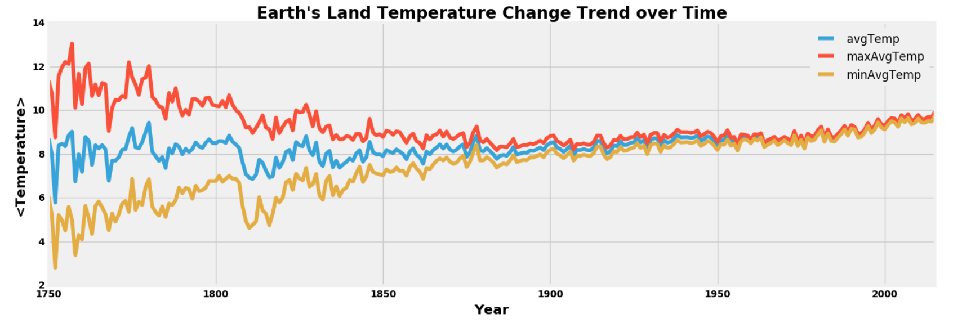
Global Temperature
Annual Trend

Slide 8
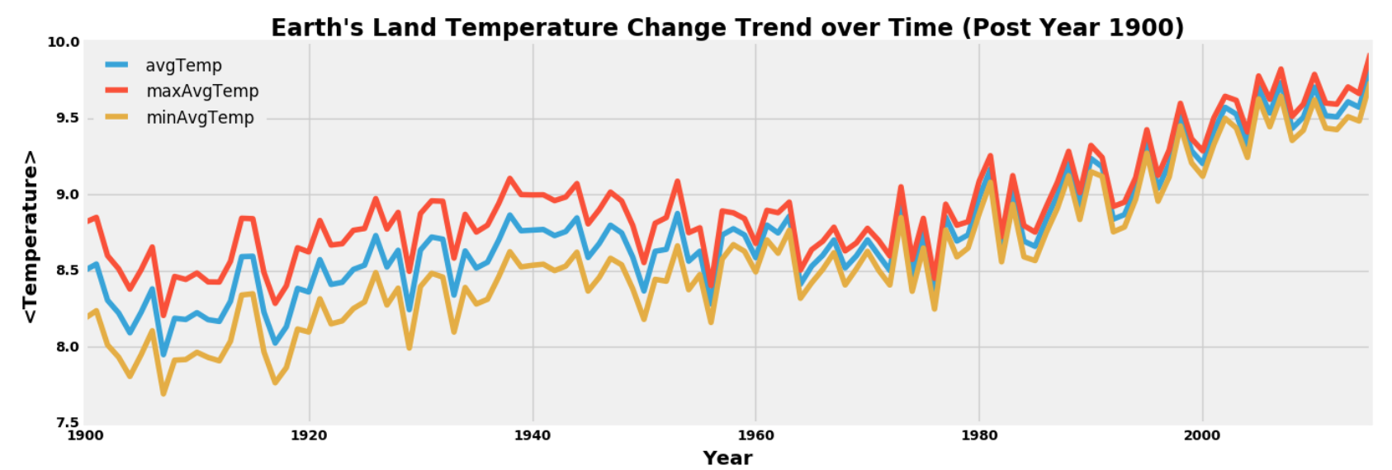
Global Temperature
Annual Trend (Last Century)

Slide 9
CO₂ Emission
Features
Year
Entity (Country Name)
Code (Country Code)
Annual CO₂ Emission (Million Tonnes)
Strategy
Aggregate values on a per-year basis across all entities

Slide 10
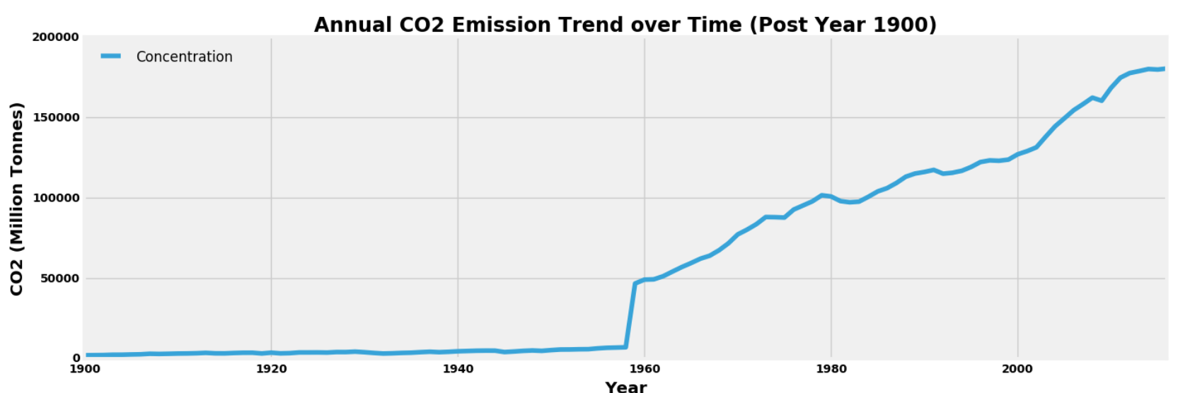
CO₂ Emission
Annual Trend (Last Century)

Slide 11
<OTHER DATASET>
Subtext
Body/bullet text with no bullet icon

Slide 12
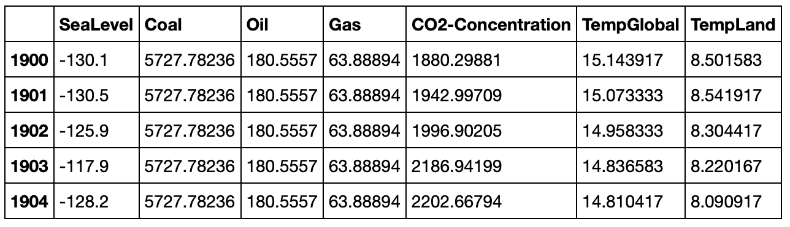
Merged dataset
Features
Notes:
Replace this snapshot

Slide 13
Clustering

Slide 14
Merged Dataset: Clustering
Analysis
Clustering : Temperature column values
Clustering : The features
Accuracy
Feature selection

Slide 15
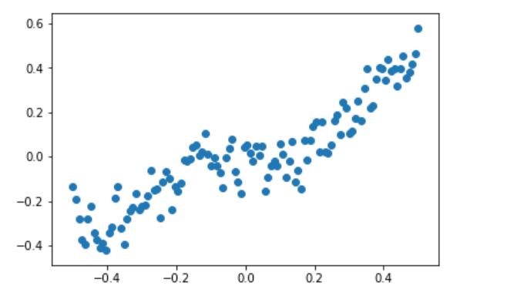
Clustering: Temperature values
Normalizing the values

Slide 16
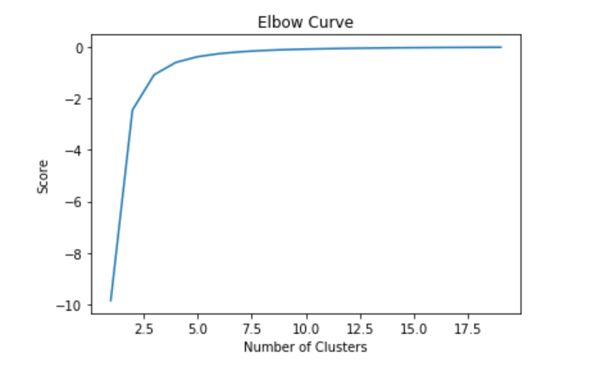
Clustering: Temperature values
Elbow curve: To determine the number of clusters

Slide 17
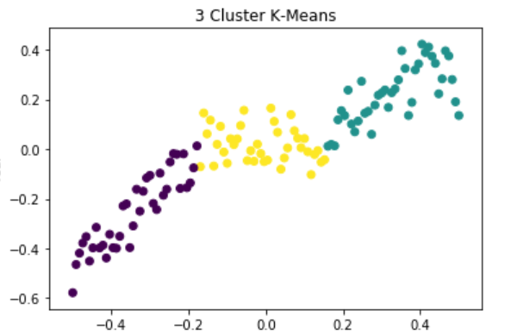
Clustering: Temperature values
K-Means Clustering (n=3)

Slide 18
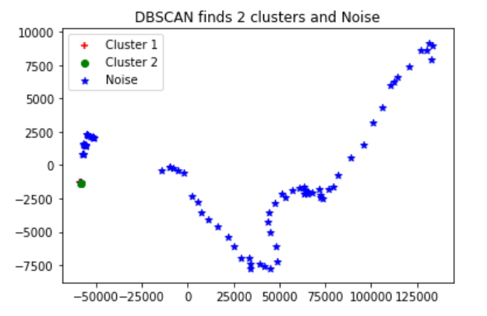
Clustering: Features
Density-Based Spatial Clustering of Applications with Noise

Slide 19
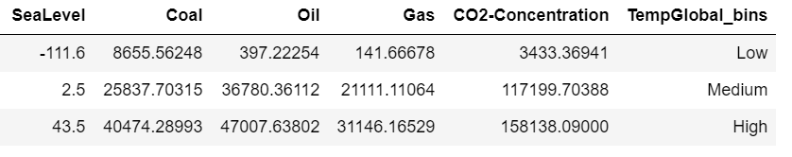
Clustering
Data binning: Temperature
Group a number of more or less continuous values into a smaller number of "bins“.
Created 3 bins
14.775, 15.204 = Low
15.204, 15.631 = Medium
15.631, 16.059 = High

Slide 20
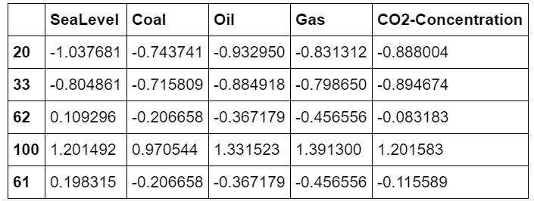
Clustering
Processing: feature data
Data is unbalanced (eg Oil is 3x Gas): feature scaling

Slide 21
clustering
K means clustering
Clustering on the 5d data and see if we can reproduce the actual clusters.
Assumption: We don't have the TempGlobal_bins labels (final labels).
Aim: Divide the data into TempGlobal_bins (i.e. low, medium and high)

Slide 22
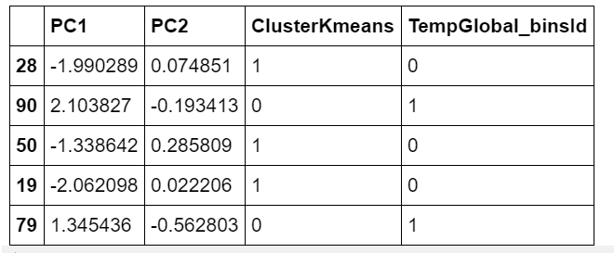
clustering
Principal Component Analysis
Goal: to reduce the dimensionality of the original feature space by projecting it onto a smaller subspace.
5 dimensional to 2 dimensional i.e. PCA1 and PCA2
Result:

Slide 23
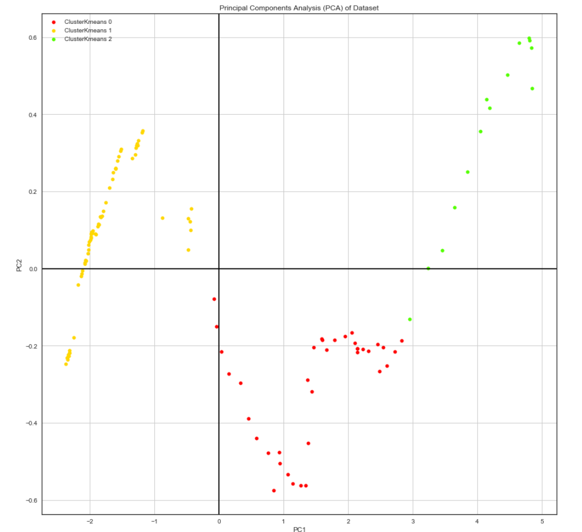
clustering
K means clustering: Predicted

Slide 24
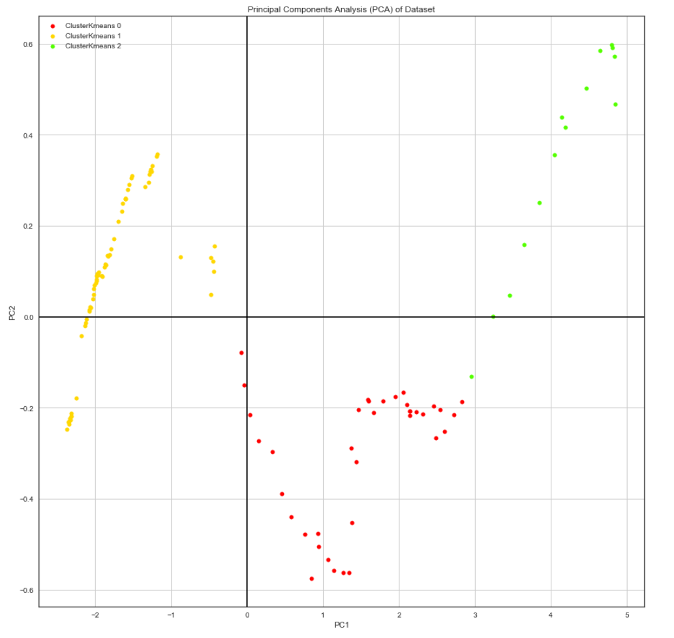
clustering
K means clustering: Actual
Accuracy: 30.73%

Slide 25
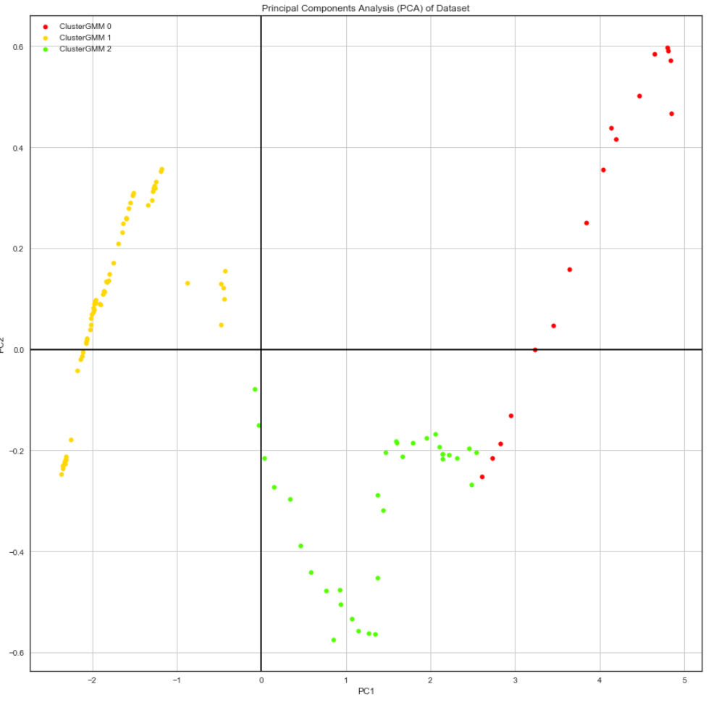
Clustering
Gaussian Mixture Model (GMM) Clustering
Accuracy: 29.60%

Slide 26
clustering
Feature Selection: Ranking of features
Algorithm | Rank1 | Rank2 | Rank3 | Rank4 | Rank5
CorrelationAttributeEval | SeaLevel | Oil | Coal | CO2-Concentration | Gas
GainRatioAttributeEval | SeaLevel | CO2-Concentration | Gas | Oil | Coal
OneRAttributeEval | SeaLevel | Gas | Oil | Coal | CO2-Concentration
InfoGainAttributeEval | Coal | SeaLevel | Oil | Gas | CO2-Concentration
PrincipalComponents | SeaLevel | Coal | Oil | Gas | CO2-Concentration

Slide 27
ClAssification

Slide 28
Template
Subtext
Body/bullet text with no bullet icon

Slide 29
Anomaly Detection

Slide 30
Template
Subtext
Body/bullet text with no bullet icon

Slide 31
Statistical Analysis

Slide 32
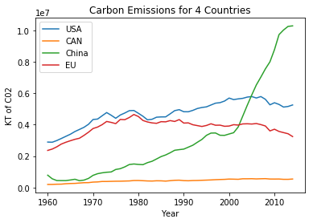
Global Emissions
By Country Basis

Slide 33
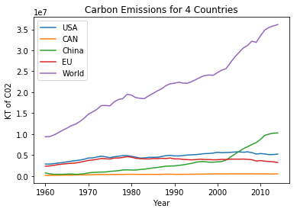
Global Emissions
Including the World

Slide 34
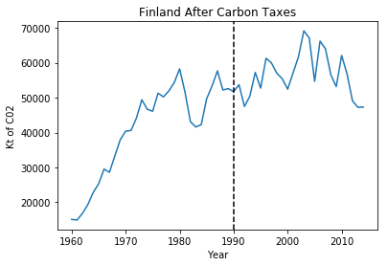
Post Carbon Taxes
Finland

Slide 35
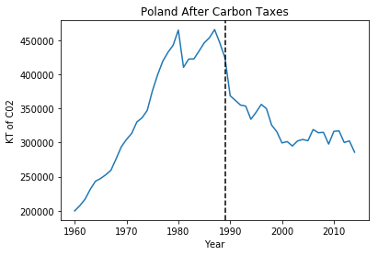
Post carbon Taxes
Poland

Slide 36
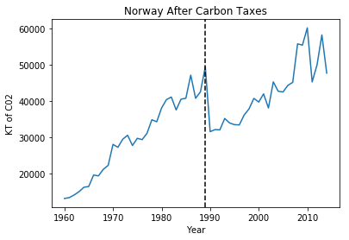
Post Carbon Taxes
Norway

Slide 37
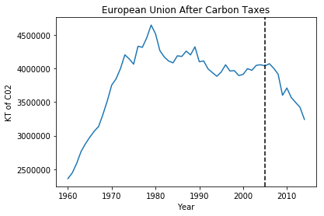
Post Carbon Taxes
European Union

Slide 38
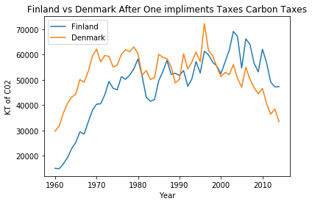
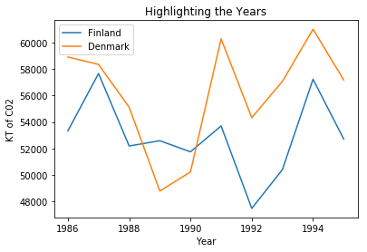
Comparable Countries
Post Carbon Taxes

Slide 39
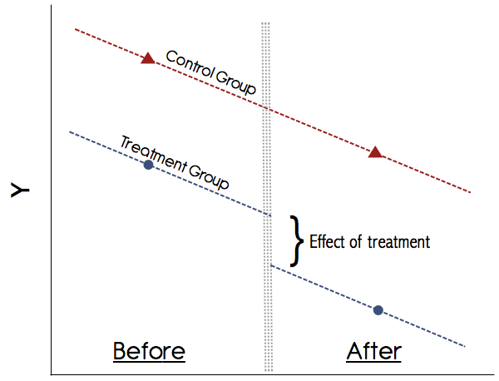
Statistical Analysis
Difference in Differences

Slide 40
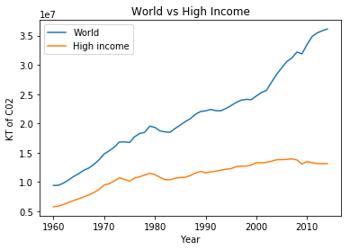
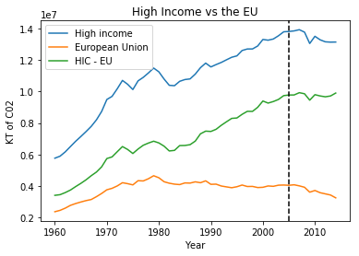
Statistical Analysis
High Income vs EU

Slide 41
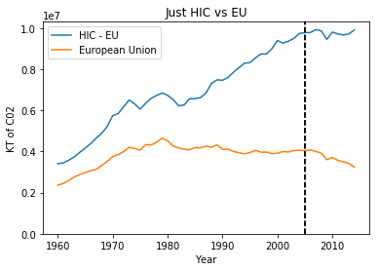
HIC vs EU
A Numbers Story
Percent Change from 2004 - 2014
-4.8% Change for High Income Countries
+1.6% Change for HIC – EU
-25.12% Change for the EU

Slide 42
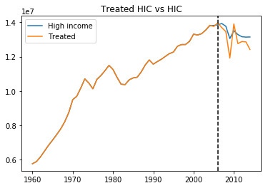
HIC vs EU
A Numbers Story

Slide 43
Natural Disasters

Slide 44
Template
Subtext

Slide 45
ConClusion

Slide 46
Learning outcomes
EECS-731
Body/bullet text with no bullet icon

Slide 47
Questions?

Slide 48
Multi-image layout 4up
Title with images
Title Goes Here
Supporting text here
Title Goes Here
Supporting text here
Title Goes Here
Supporting text here
Title Goes Here
Supporting text here

Slide 49

title
Subtitle
Text goes here
Text goes here
Text goes here
Text goes here

Slide 50

Imagery, chart and text
Subtitle
Use body text sparingly on slide types that include other information, such as, an image and data/chart. Too much on the slide might be hard for the viewer to take in.

Slide 51
“ Quoted text example goes here. Trebuchet, 42 pt. Use with shorter (headline type) quotes.”
Quote Source, Trebuchet 16 pt

Slide 52
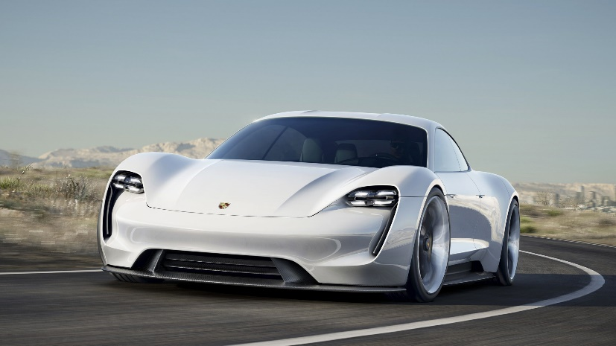
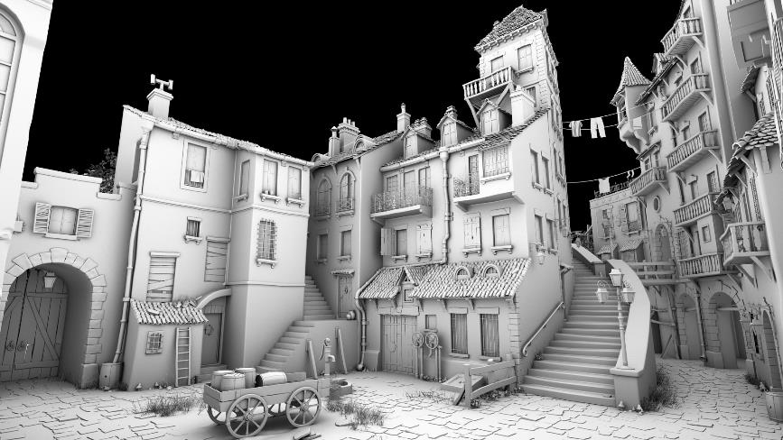


Timeline with images
Text Goes Here
Text Goes Here
Text Goes Here
Text Goes Here
xxxx
xxxx
xxxx
xxxx
Source: Source information is 8 pt, italic

Slide 53
World map
<Explanation>
Helsinki
Santa Clara
Tokyo

